Slide 1
MODHMS Working Files

Slide 2
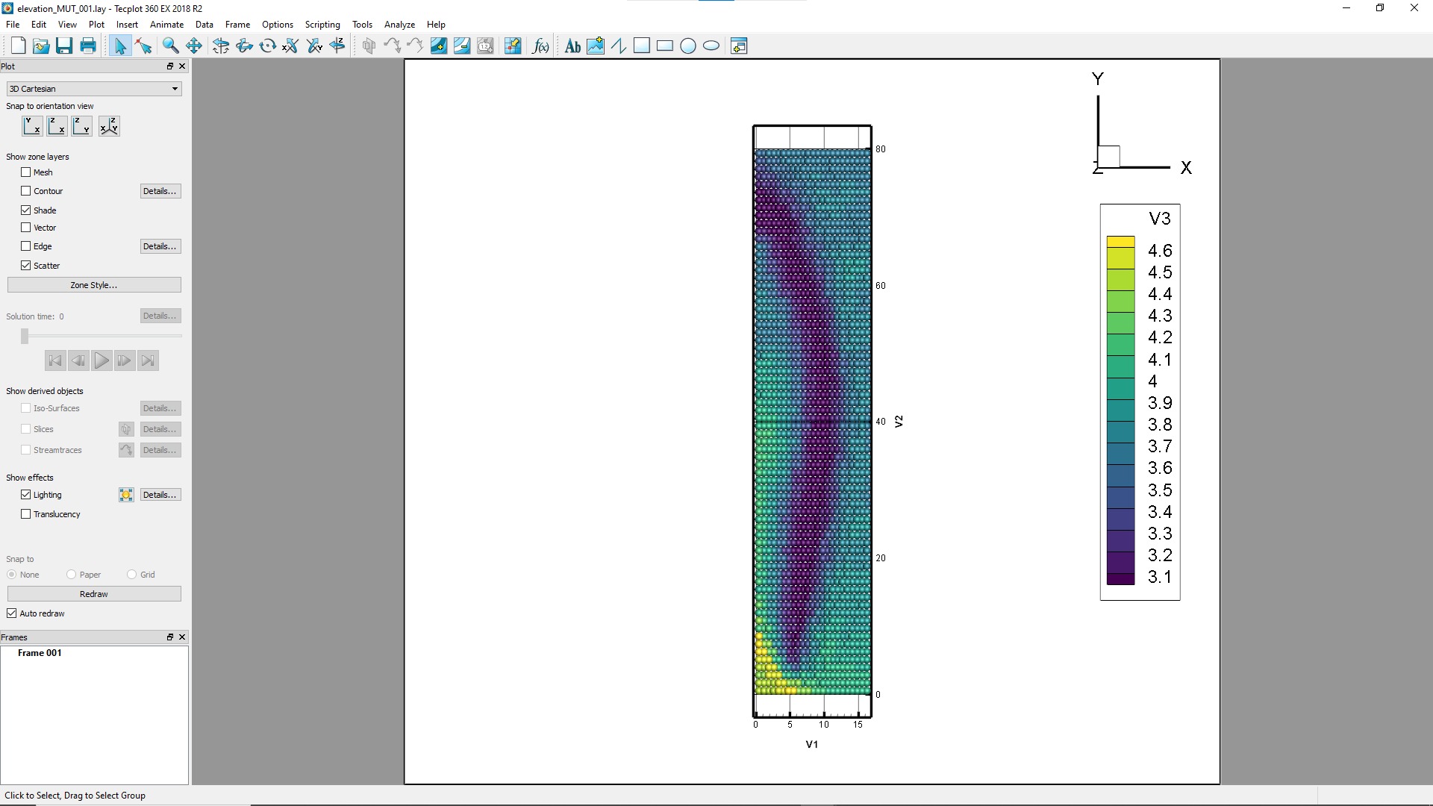
The raw data for the top layer elevation needs to be mirrored in X

Slide 3
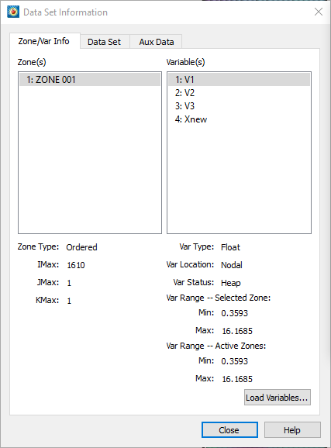
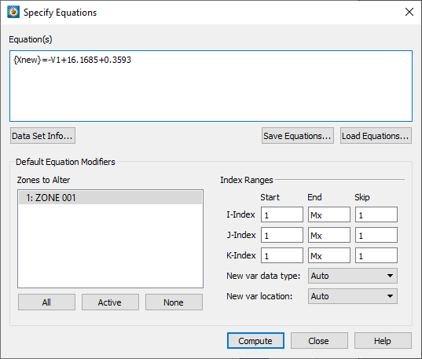
Define a new variable Xnew to mirror the elevation data

Slide 4
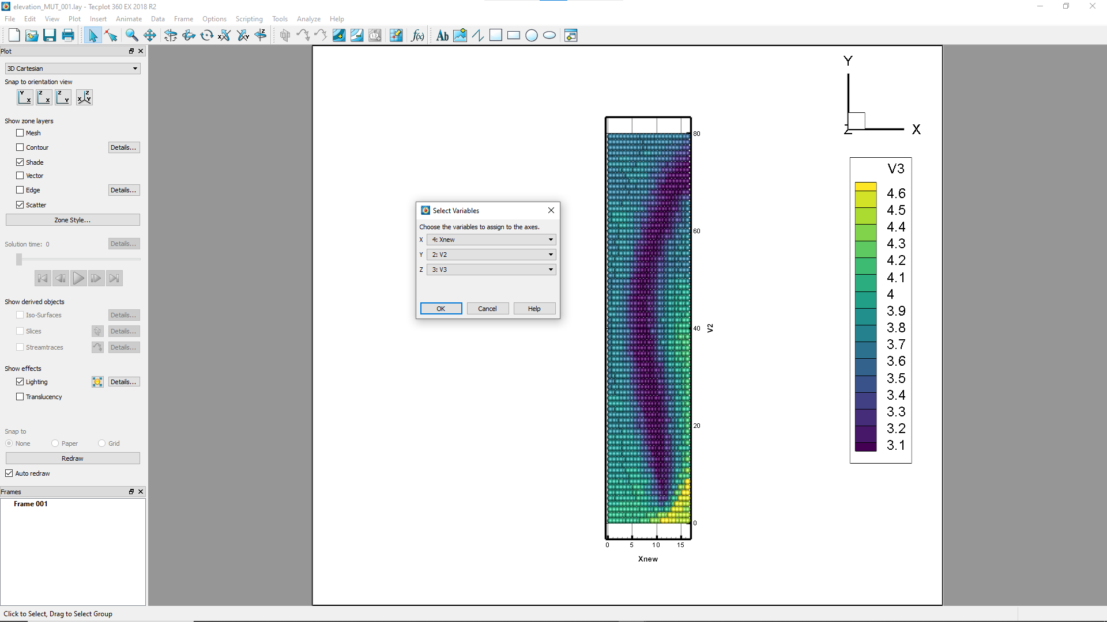
Assign Xnew as the X-axis variable.

Slide 5
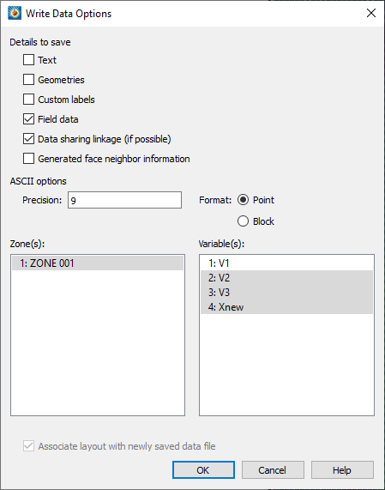
Write the Y (V2), cell elevation (V3), Xnew to a new file

Slide 6
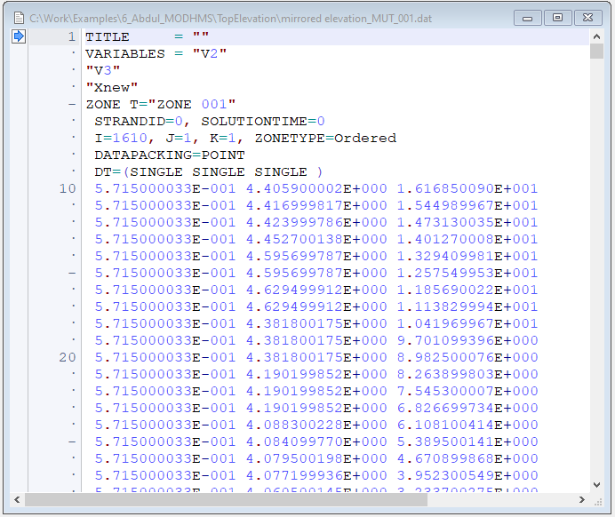
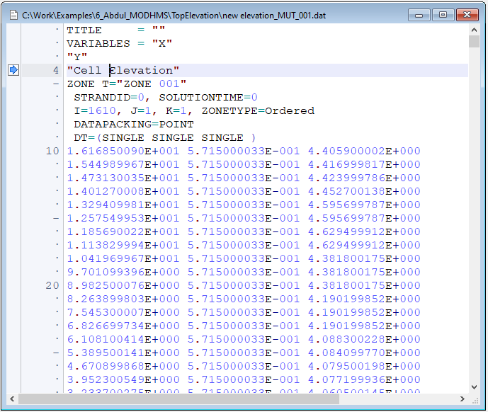
Move the Xnew column to the left side and rename the varibles X, Y and Cell Elevation
Save this as ‘new elevation_MUT_001.dat’

Slide 7
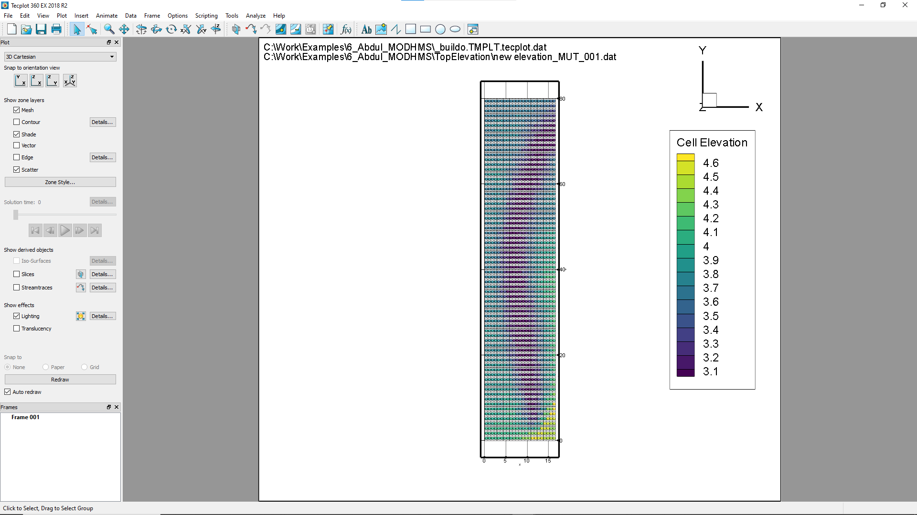
Load the template mesh into Tecplot
Load the cell elevation points

Slide 8
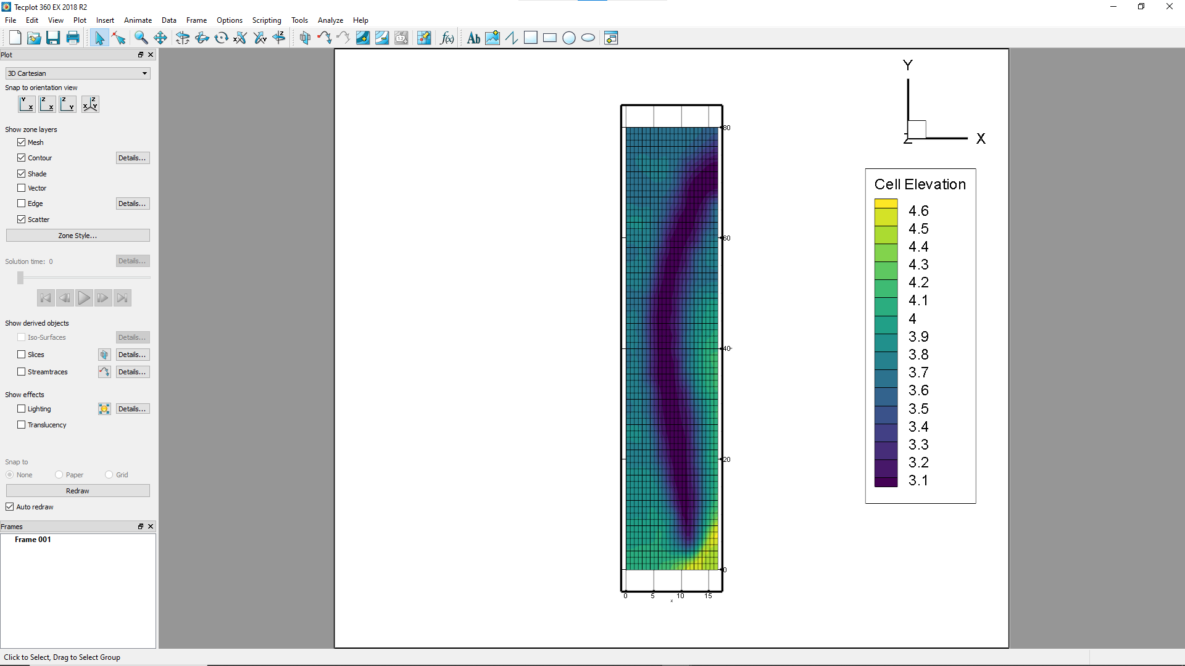
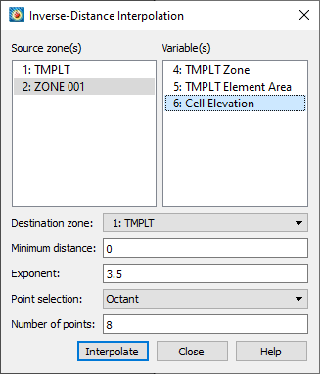
Interpolate using Inverse Distance because Kriging did not work

Slide 9
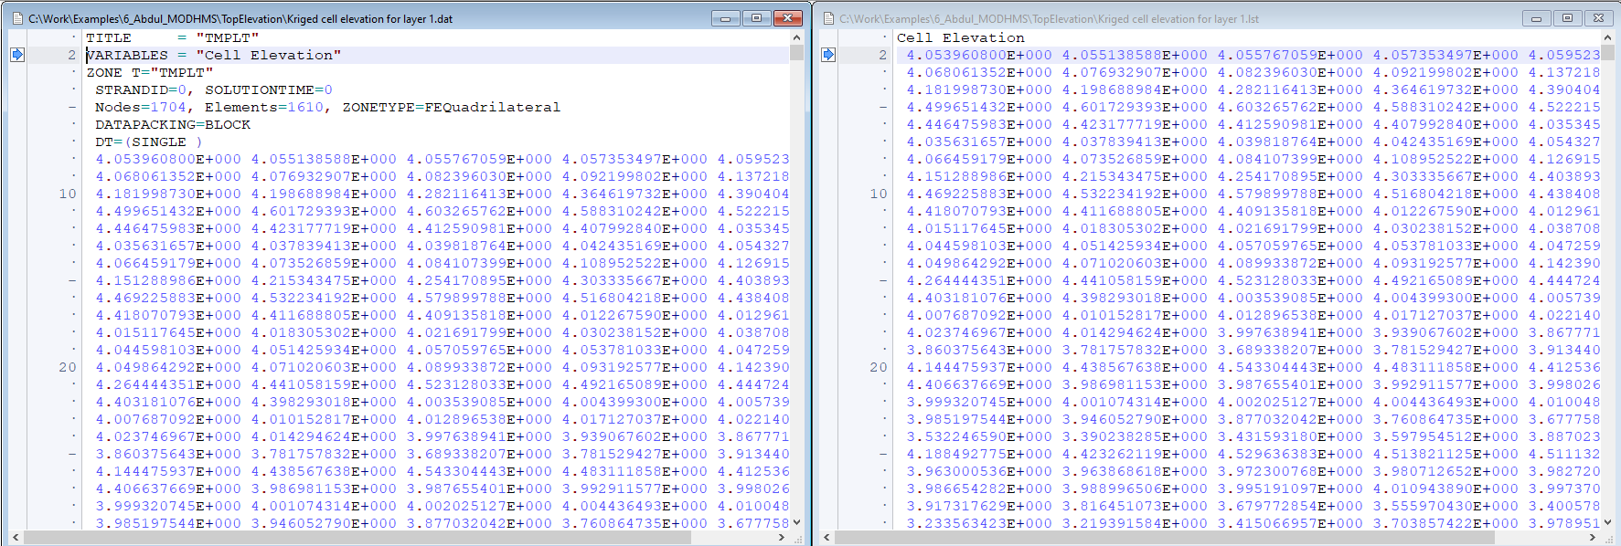
Write the cell elevations to a file
Convert and save the file so it can be read by ‘elevation from list file’ instruction

Slide 10
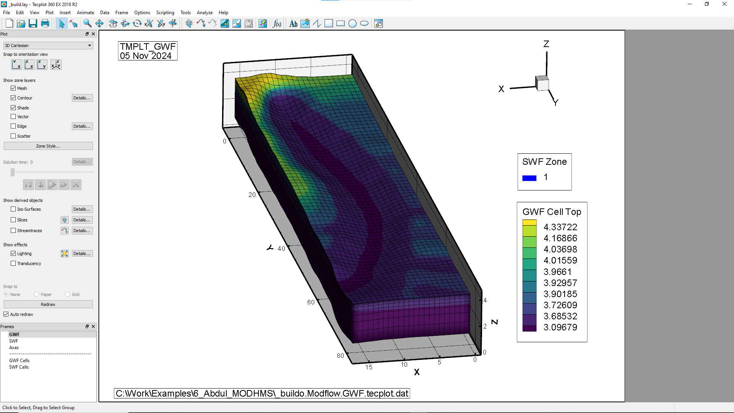
Run mut _build
Load build.lay
Contour GWF cell top

